Slide 1
MGMT-6121 Business Intelligence Dashboard Project
By Jenab Vohra, Jay Mangnani, and Andrea Illes
9 December 2019

Slide 2
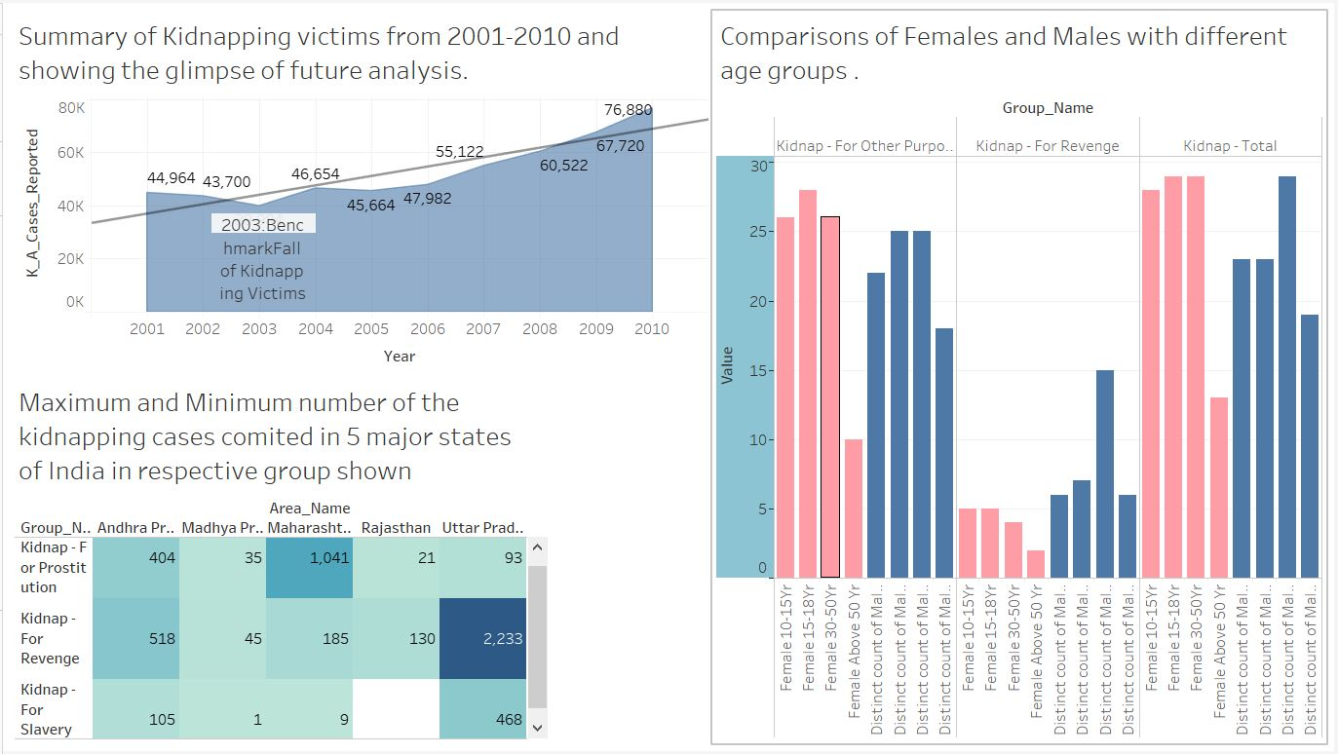
Jenab Vohra

Slide 3
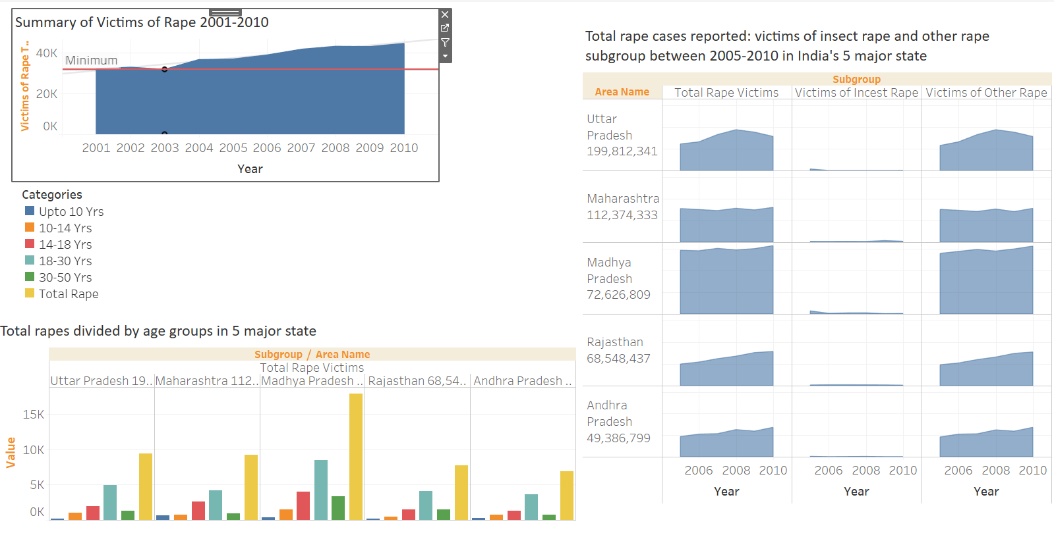
Andrea Illes

Slide 4
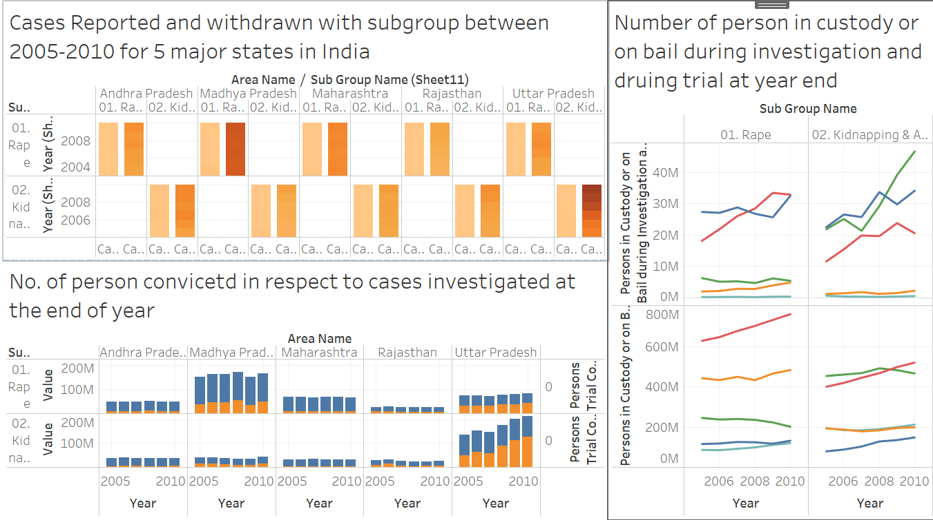
Jay Mangnani

Slide 5
Lesson learned
We had to change our topic (from Cricket World Cup 2019 to Crime in India)
because the first dataset didn’t work properly when we tried to load into Tableau.
We all chose individual data files that were full of similar information which individually
was great but when we got together and tried to connect our story, we had difficulties
to draw an informative story.
It was very time consuming to put our story together and we were juggling with the data.
There was not enough time to adequately analyze the data. We feel like we could spend more time with data collecting, cleaning, ETL and make sure that our data is clear and true on the dashboard and our visualization is informative.

